Slide 1
Better School Lunches
By Daniel Shim, Bradley Mellott , and Ryan Ortiz

Slide 2
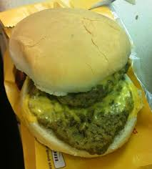
Introduction
Our project was based on the topic ‘Better School Lunches’.

Slide 3
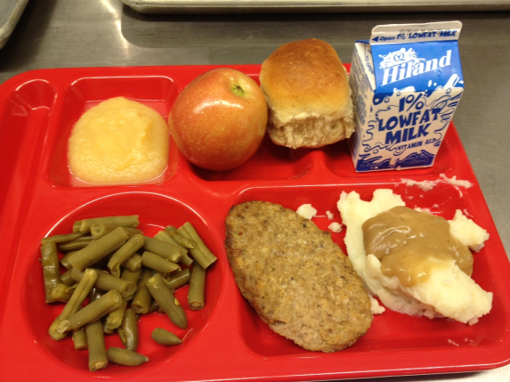
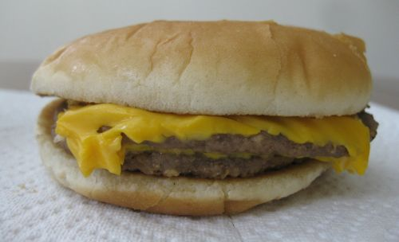
Some information
The school lunches we have right now is not very good.
Other schools lunches make ours look like trash.
≠

Slide 4
Some more information
School lunch actually only costs about 1 dollar to the school but for us it costs 2.50 and the school lunch is bad. Let alone how they make it.
CHICKEN NUGGETS: $0.30, BREAD ROLL: $0.12 , CORN: $0.10, SALAD: $0.12, FRUIT: $0.13, MILK: $0.20
TOTAL: $0.97

Slide 5
In Conclusion…
Our school lunches aren’t too great and they cood be better but they are half decent now but other schools have better lunches and

